Slide 1
Playback Presentation

Slide 2
Table of Contents
KT Session Overview
Overview of Application
Interfaces
Sub system overviews
Data flow between Interfaces
Environmental Details
Tools and Technologies

Slide 3
KT Session Overview
Application name | TRANSACT
No. of sessions Planned | 6
No. of session Conducted | 6
Reason for variation (if any) | To address knowledge gap in component details
Topics covered | Business functionality, Interfaces and various components & Technical architecture.
Name of SCB SME/s | Arabia , Christian De La Rosa
Name of HCL SME/s | Sravya , Shriram
Mode of KT session | Face 2 Face
Name of documents referred during KT | TRANSACT Interface documents, Sample data documents, TRANSACT Functional document

Slide 4
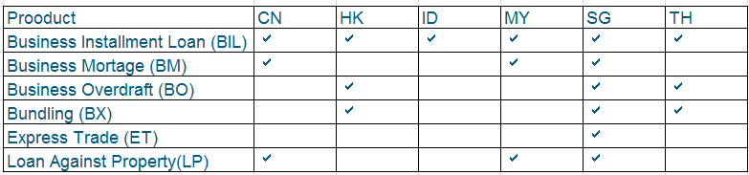
Overview of TRANSACT
TRANSACT is a web based loan origination system for Business Loans. GAI ID is 15670.
Country of Business supported: Malaysia ,Singapore , China , Indonesia , Thailand , Hongkong.
TRANSACT is used to on board the loan application for SME Customers.
This application primarily used by Sales, operations, Credit, and SM teams .
Products supported by TRANSACT systems.

Slide 5
Overview of TRANSACT
Business Instalment Loan (BI) :
Business Installment Loan (BIL) is a flexible financing solution.
No collateral required.
Only guarantee from your directors and/or shareholders is/are required.
Repayment period between 12 to 84 months.
Express Trade (ET) :
Express Trade Services (ETS) provides you with a quick and simple one-stop
trade financing facility that is customized based on your business needs
Credit decision in just 2 working days
Loan against property (LP) :
Business Loan is provided against property.

Slide 6
Overview of TRANSACT
Bundling (BX) :
Two or more products can be combined and offered to Business Customers.
Business Mortgage (BM) :
Mortgage is given for business purpose where business itself is the collateral.
Business Overdraft (BO) :
Finance required for day-to-day short-term cash flow requirements is fulfilled by
taking flexible Business Overdraft facility.
BO is a revolving borrowing facility repayable on demand, made available in
connection with a current account.
Interest is charged on the amount used.
Minimum 3 years of business operations is required.

Slide 7
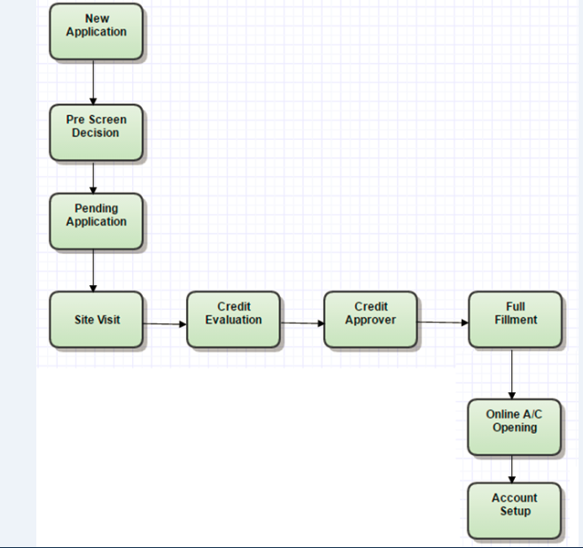
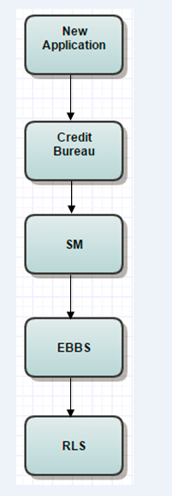
TRANSACT – BIL Workflow
Summary

Slide 8
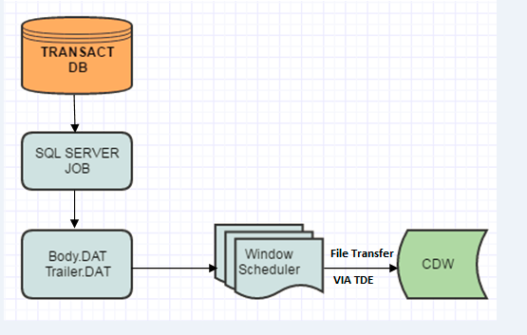
TRANSACT – CDW Interface

Slide 9
TRANSACT CDW- Interface
Extract Transact data into text file format (.dat) according to selected database tables for 5 countries i.e. SG, MY, HK, TH & CN.
Once a table is extracted, the table will be transformed into 2 separate .dat files with file name “BODY.dat” and “TRAILER.dat”. These files is saved in a folder where the folder name carries the same name as the table name i.e. ApplicationData1.
When the extraction ends, both files “BODY.dat” and “TRAILER.dat” are merge into single .dat file in the format : TRN_ApplicationData1_{country Code}_M_ddmmyyyy.dat
The names of the scheduler is windows.

Slide 10
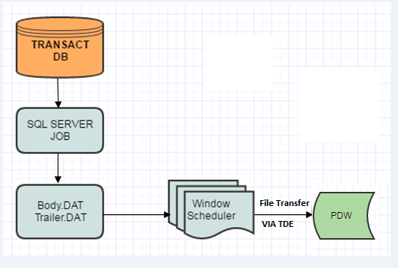
TRANSACT – PDW Interface

Slide 11

TRANSACT PDW- Interface
PDW is a batch program that extracts Transact data into a CSV file and sends the file via TDE file transfer to
PDW interface. Countries such as China, Honkong, Malaysia and Singapore are impacted.
Sample File names:
Smerisk_keyman_201205.csv
Smerisk_loanapp_201205.csv
Windows batch Job and Scheduler Details are as follows :

Slide 12
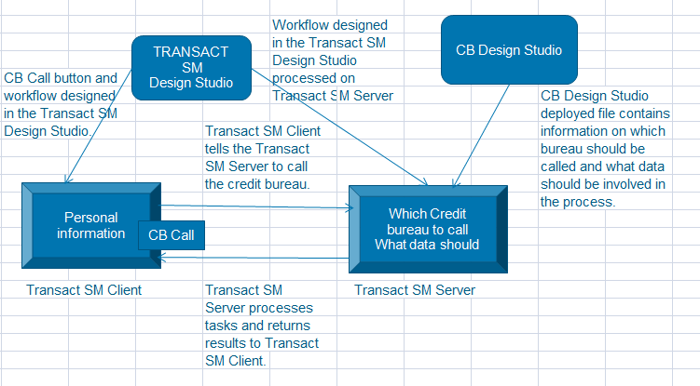
TRANSACT – Bureau Interface

Slide 13
TRANSACT – Bureau Interface
The Credit Bureau Design Studio creates a file with the .cbg extension. As part of the sequence in the Transact Design Studio the server will be told to call the bureau and at that point it will interrogate the .cbg file in order to determine which bureau should be called and what data should be involved in the process.
The CB Design Studio is used to define the processes involved in calling a credit bureau: Which credit bureau to call, which data to send and receive, and which calculations to be carried out as part of the bureau call.
Bureau will give positive and negative information about client credit rating.
Transact can incorporate the ability to call multiple bureaus in an effort to gain the information required for application decision process in the Strategy Manager System. The Credit Bureau Design Studio tool allows a Transact user to build a library of bureau calls and attribute generations that can then be incorporated into the Credit Bureau Design Studio sequence so the bureau call can be placed into the flow at a time that is appropriate.

Slide 14
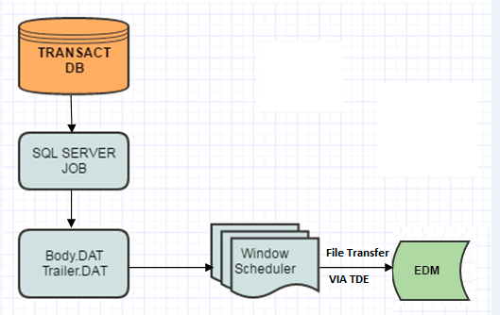
TRANSACT – EDM Interface

Slide 15
TRANSACT EDM- Interface
Extract Transact data into text file format (.dat) according to selected database tables for 5 countries i.e. SG, MY, HK, TH & CN.
Once a table is extracted, the table will be transformed into 2 separate .dat files with file name “BODY.dat” and “TRAILER.dat”.
When the extraction ends, both files “BODY.dat” and “TRAILER.dat” are merge into single .dat file in the format : TRN_ApplicationData1_{country Code}_M_ddmmyyyy.dat
The names of the scheduler is windows.

Slide 16
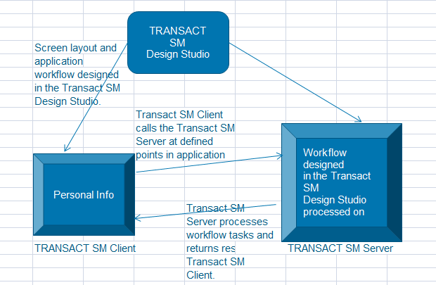
TRANSACT – SM Interface

Slide 17
TRANSACT SM- Interface
The Transact SM Design Studio allows you to define all the system components and produce the workflows. It is also used to design the Transact SM Client interface (screens and menus). Integrated into Transact SM Design Studio is the Builder application where you define the Transact SM database tables and their characteristics, as well as the decisioning system structure.
SM is a decision making agent which decides whether loan has to be approved or rejected based on the rules defined by Business.
Files are transferred to SM in batch mode.
File format is Text.
SM stands for Strategy Manger.

Slide 18
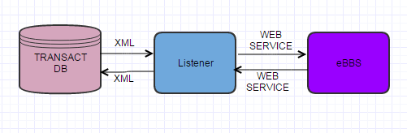
TRANSACT eBBS - Interface
It is a Core banking system and mainly interacted For Customer Enquire/ Account Creation.

Slide 19
eBBS – TRANSACT Interface Dataflow - contd
NTB customers:
Search customer information.
Profile creation is done in eBBS only after loan is approved.
Disbursement account information is sent to eBBS after loan is approved.
For rejected loan application, no profile is created in eBBS.
ETB customers:
Search customer information and DeDup validation is performed.
Rel ID (unique ID) for the ETB customer is received.
Disbursement account information is sent to eBBS after loan is approved.

Slide 20
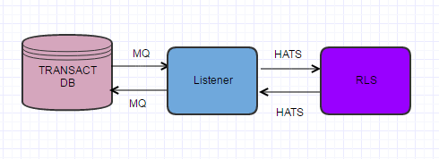
TRANSACT - RLS Interface
RLS Stands for Retail loan system.
TRANSACT is communicate with RLS via MQ HUB in the xml file format
After loan is approved, loan is created in RLS.
RLS is a mainframe server , so it can not be able to read the xml file, to make file readable we have to use HATS.

Slide 21
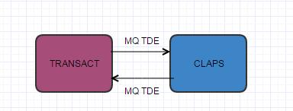
TRANSACT - CLAPS Interface
TRANSACT will send the data to CLAPS to check the Black list customers.
Files are transferred to CLAPS in batch mode.
File format is text.

Slide 22
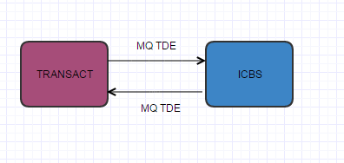
TRANSACT – ICBS Interface
ICBS is counter part of eBBS in Thailand.
All features and functionalities used in eBBS are available in ICBS.
Files are transferred to ICBS in batch mode.
File format is text.

Slide 23
Environment Details - TRANSACT
There are 5 dev/test/regression VM servers maintained by project team and supported by India server team
IP Address | Server Name | Platform / DB / MQ
10.112.176.40 | SMEDEV001 | W2K3 / MS SQL 2005
10.112.176.41 | smedev002 | W2K3
10.112.176.88 | mywltvud01 | W2K3 / MS SQL 2005 / MQ
10.112.176.89 | mywltvud02 | W2K3
10.112.176.72 | smedev003 | W2K3
2. Transact Production/DR Servers include HKGRAPNANSME03/R and HKGRAPNANSME04/R and HKGWKGPANDUP01/R (Dup Server)

Slide 24
Tools - TRANSACT
Tool Name | Purpose | Brief Description
Visual Studio 2008 | IDE | To write code for developing UI, business logics
SQL Server 2005 Management Studio | Database | Backend database for TRANSACT
Tortoise SVN | Source Control | Source code repository

Slide 25
Technologies - TRANSACT
Software | Version
Microsoft Framework | 1.1
SQL Server | 2005
IBM WS MQ | 6.0
IIS | 6.0
TRANSACT SM Design studio | 5.0

Slide 26
History of Data changes
Project ID | Change | Release Date | Country | Description
As the description for the changes is big, we have attached the changes document.

Slide 27
Upcoming Release Plan
S. No | Change Request | Status | Tentative implementation Date | Region | Description
Transact SM R1V5 | CRQ000000381590 | Implementation in progress | 11 Feb 2017 | HK
ICM-MY |  | UAT | 11/25 March 2017 | MY
ICM-SG |  | UAT | March 2017 | SG

Slide 28
Key Processes and Procedures
Process Name | Description
Requirement Analysis | Once Business Requirement Document is obtained from Business Analyst after sign off , Tech Lead will Analyse the requirement , Technologies to be implemented , Resources and Estimation for this requirement.
Design | Tech lead will provide Structure of the Project , Stream to deliver the change in Version Control Tool , UML diagram for the given requirement and Statement Of Work on code flow from Presentation tier to Persistence tier.
Construction | After finalizing the requirement and design , developer will start to work on implementing the requirement. Code review will be done by Lead after the development.
Testing | Unit test case will be prepared by the developer that includes testing the modules within the application system. Connectivity testing will be established for the interface system.
Release | Arrange KT to PSS and get the sign off for PSS KT. Prepare the PRA sheet and send it to TSM and get the approval. Send the change list and supporting document to the CAB coordinator. Arrange the walkthrough with implementer , if required. Production DOD needs to raised and get the production binaries. Once the change was submitted, then approvals needs to get from implementer. Change will be presented in the precab and get the precab approval. Once the precab is approval then the change will move to CAB. Change will be present in the CAB and get the approval. Implementer will do deployment according to the AIG. Sanity verification will be done by Dev team. Once the deployment is completed , the Dev team will ask the business user will do the testing. Business user will share the UVT sign off.

Slide 29
Business Users
Around 159 are exist for TRANSACT application in Singapore.
Those user List is available in the attached excel.

Slide 30
Q & A

Slide 31
Thank You

